Slide 1
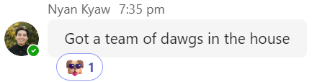
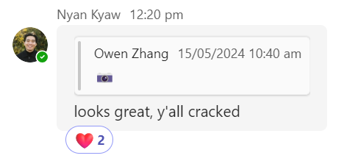
CNN:
WHAT IS THAT?
Philippe Yong, Sam Kernich, Philip Cho, Geva Hilzenrat, Owen Zhang, Sophie Xu

Slide 2
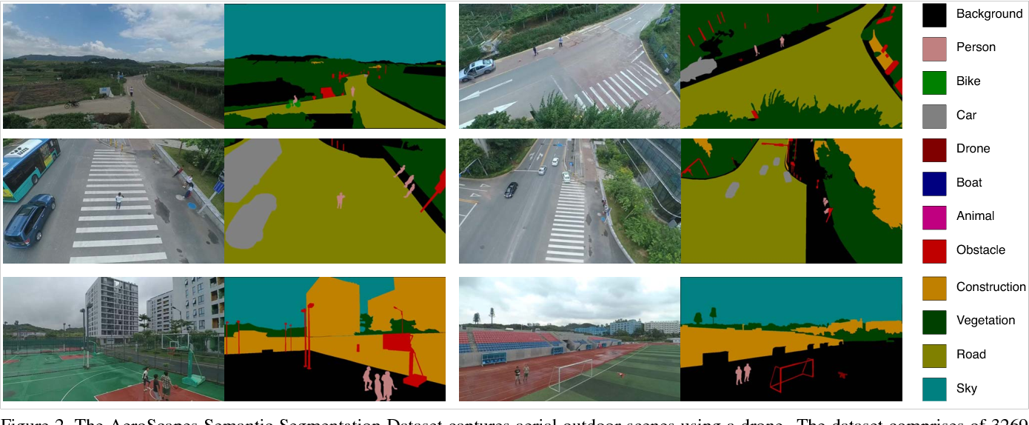
PROBLEM SCOPE
Objective:
Goal:
Train a convolutional neural network model that is able to differentiate different objects from aerial drone footage.
Understand how semantic segmentation works and create a model that differentiates different objects from drone footage

Slide 3
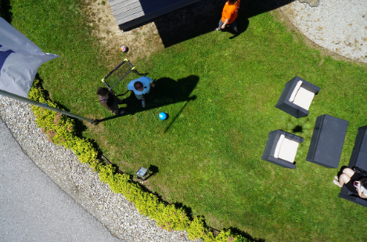
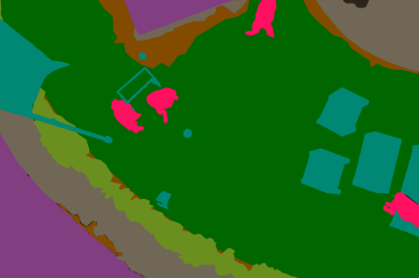
DATASET
This dataset contains 400 aerial photos (size 6000 x 4000 pixels) of urban scenes taken from 5-30 metres above the ground. It contains pixel accurate annotation of 24 different classes.
24 Labels:
Tree Grass Other Vegetation Dirt Gravel Rocks Water Paved Area Pool Person Bald tree AR Marker | Dog Car Bicycle Roof Wall Fence Fence-pole Window Door Obstacle Unlabelled Conflicting
Notes:
Aerial photos of urban scenes
400 images of size 6000x4000px
Pixel-accurate annotation containing 20 classes

Slide 4
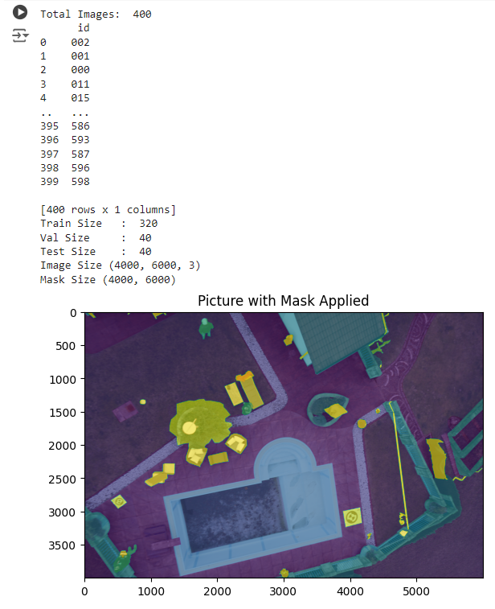
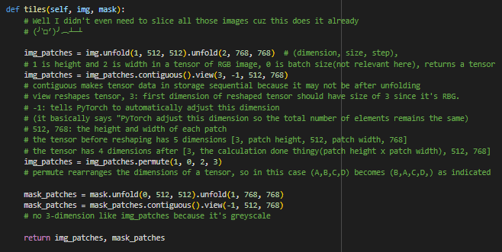
DATASET
Improvement:
Parts of images weren’t used which could affect output
Using padding/overlapping so that all parts of the images are used
Notes:
Aerial photos of urban scenes
400 images of size 6000x4000px
Pixel-accurate annotation containing 20 classes

Slide 5
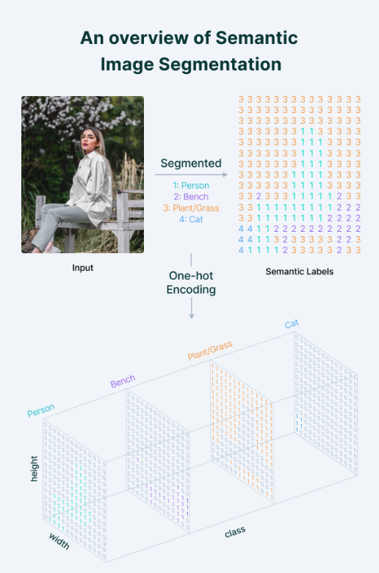
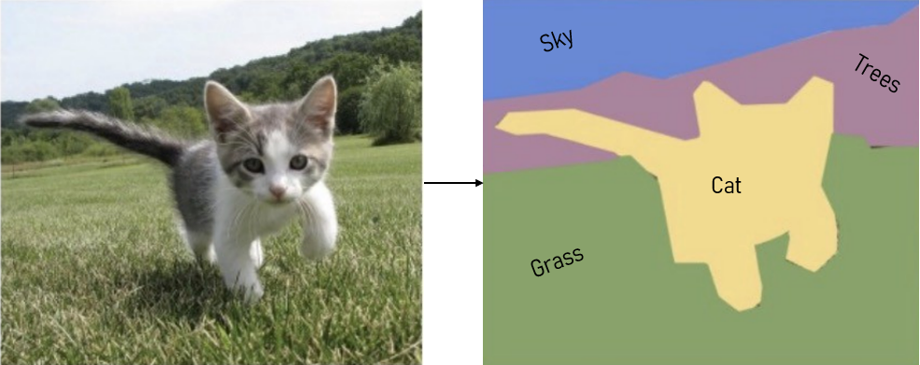
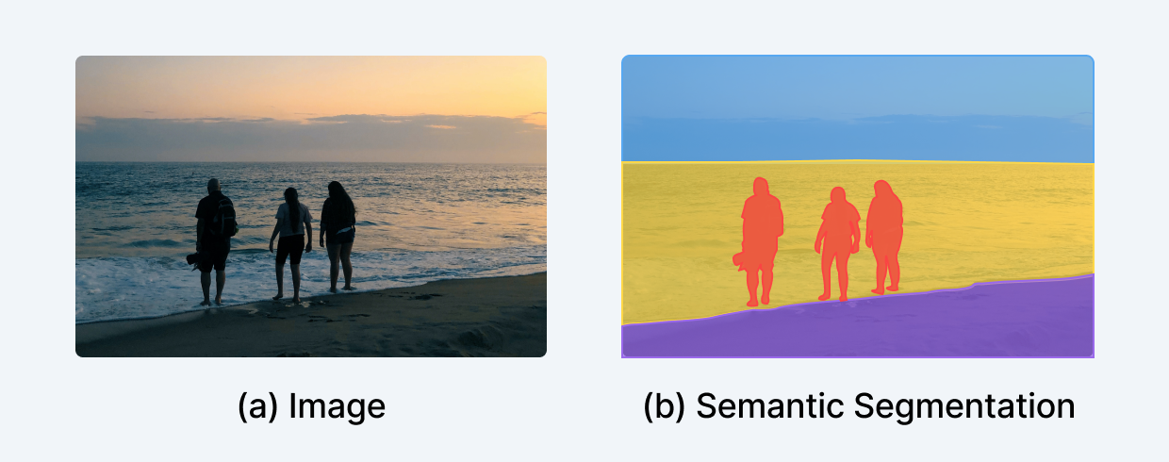
SEMANTIC SEGMENTATION
Semantic segmentation is a form of computer vision technology used to identify objects in an image or video
Assigns a label to every pixel in the image
Outputs a “mask” containing the values assigned to each pixel
Numerous applications such as medical image analysis, self-driving cars, facial recognition, etc

Slide 6
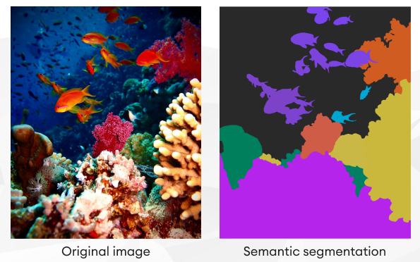
SEMANTIC SEGMENTATION
Advantages
Disadvantages
Higher accuracy
Able to identify specific objects in complex scenes by boundary
Able to identify multiple objects within an image or video
Requires large amount of labelled data for training the model
Can be computationally expensive

Slide 7
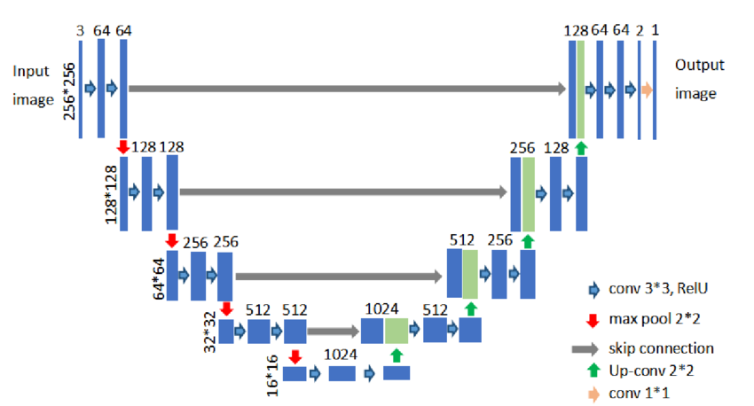
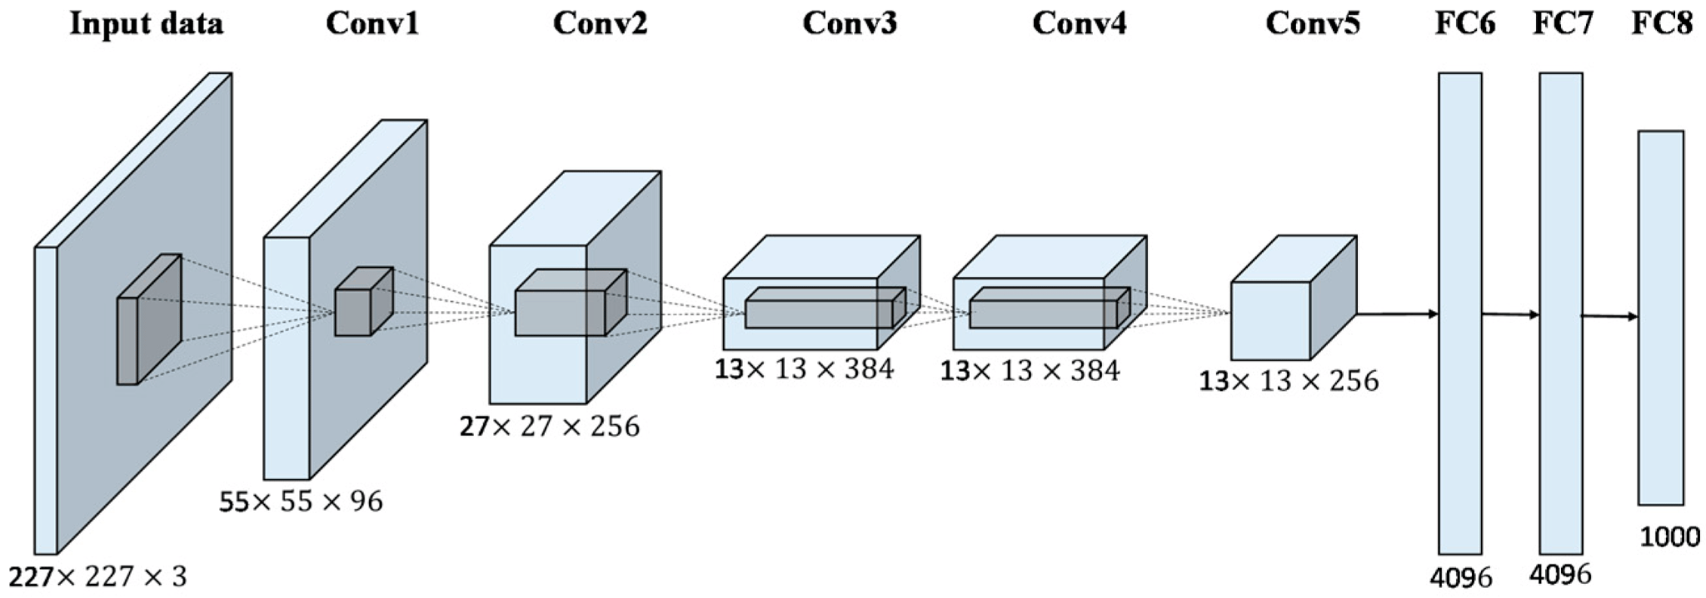
U-NET
Fully convolutional network
U-net uses a skip connection to extract features to upsample, tackles information loss problem, where information is lost in max-pooling layers
Convolution blocks in the contractive part send extracted features to corresponding transposed convolution block in expansive part

Slide 8
WHY U-NET
Advantages
Disadvantages
Simple Structure
Skip paths decreases loss of information between layers, which can increase accuracy of the output
Works well on smaller data sets
Lots of parameters because of the skip paths, which can make the model more prone to overfitting
Requires lots of memory

Slide 9
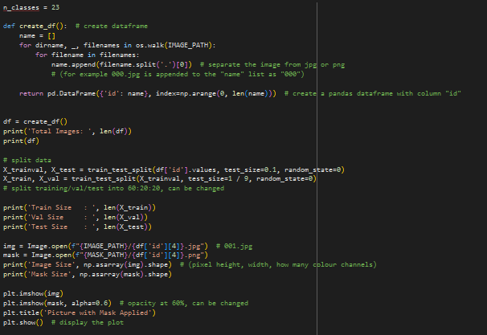
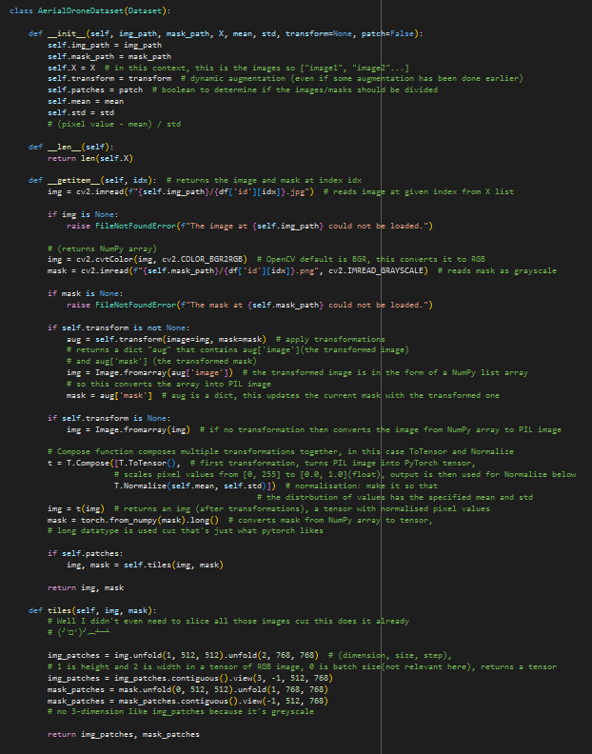
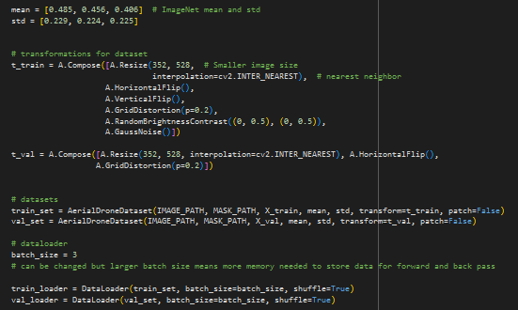
TRAINING

Slide 10
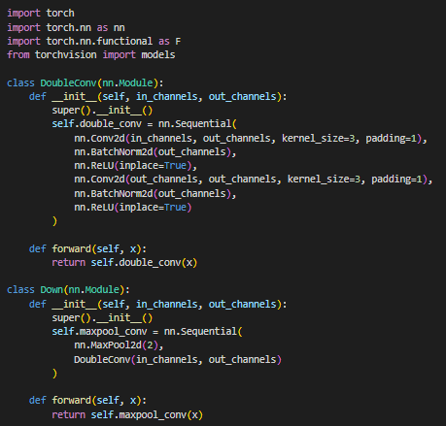
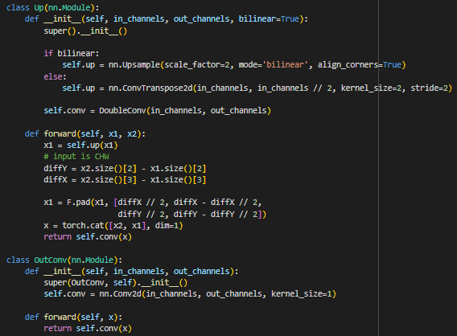
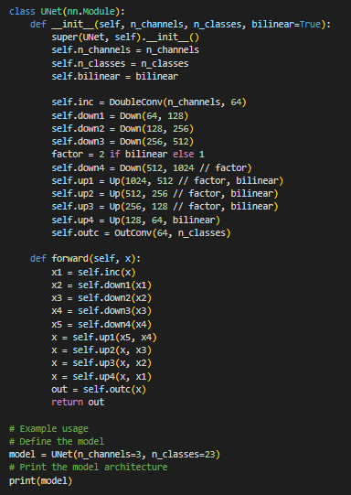
TRAINING

Slide 11
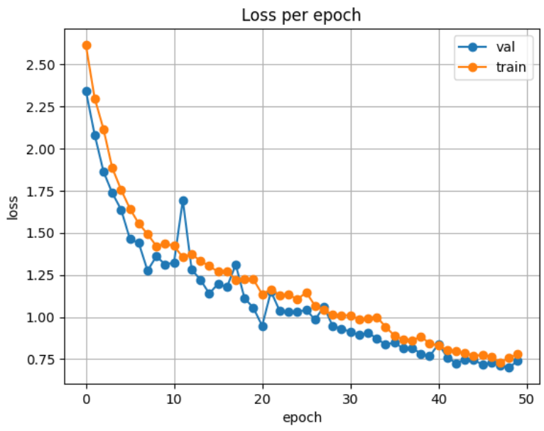
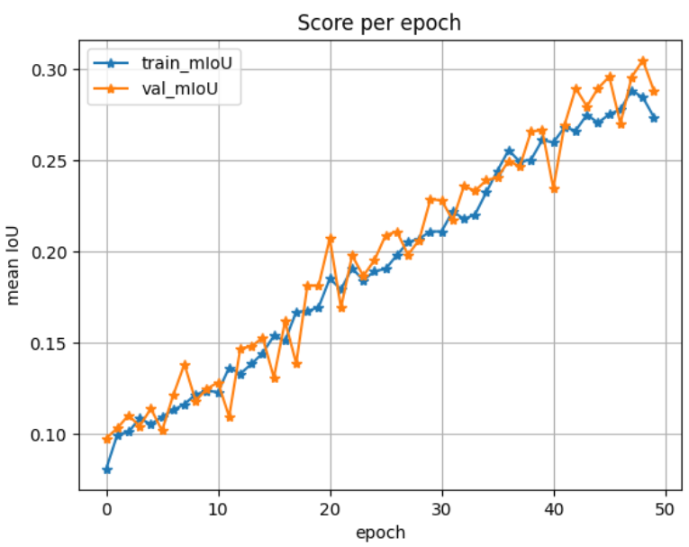
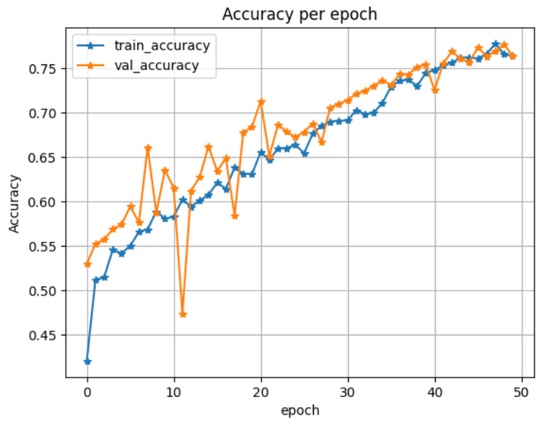
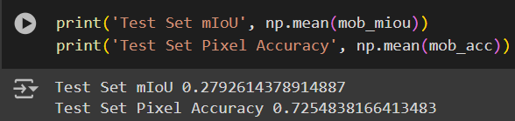
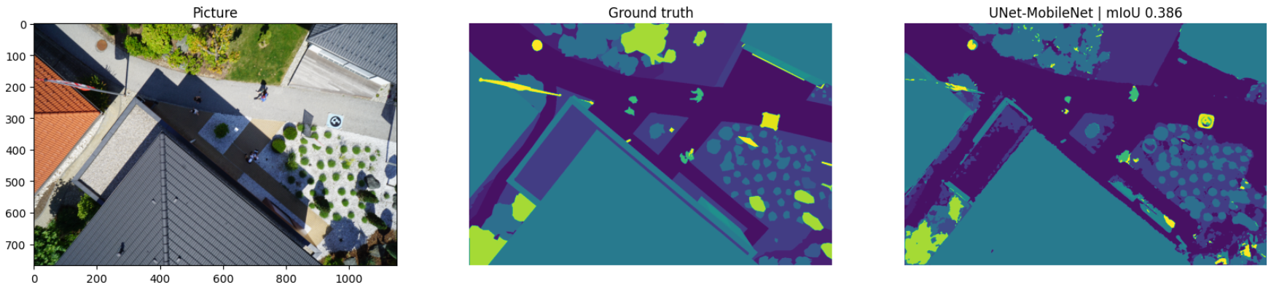
TRAINING
Epochs: 50 Split: 80:10:10 training, validation, testing split

Slide 12
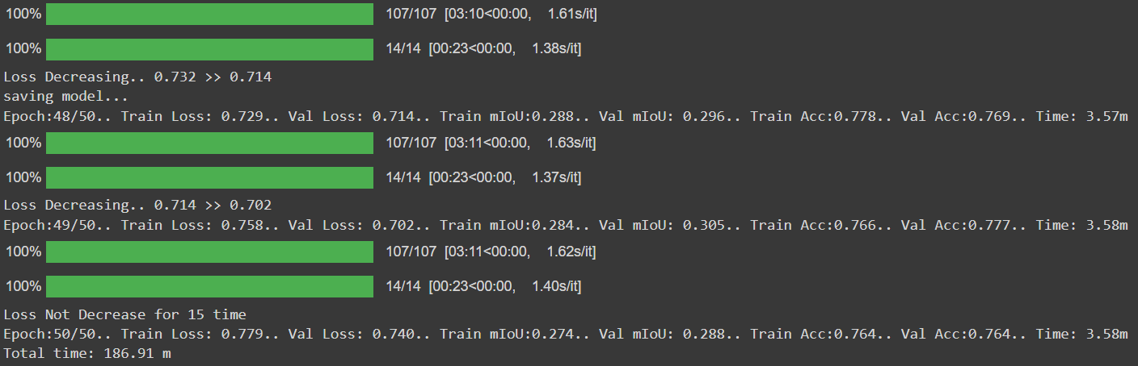
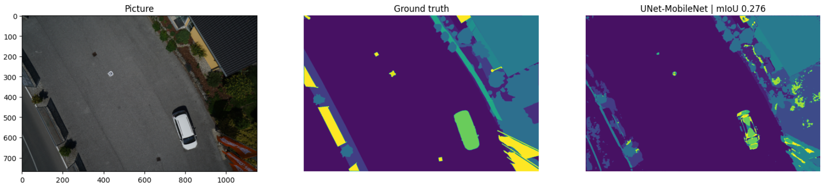
TRAINING

Slide 13
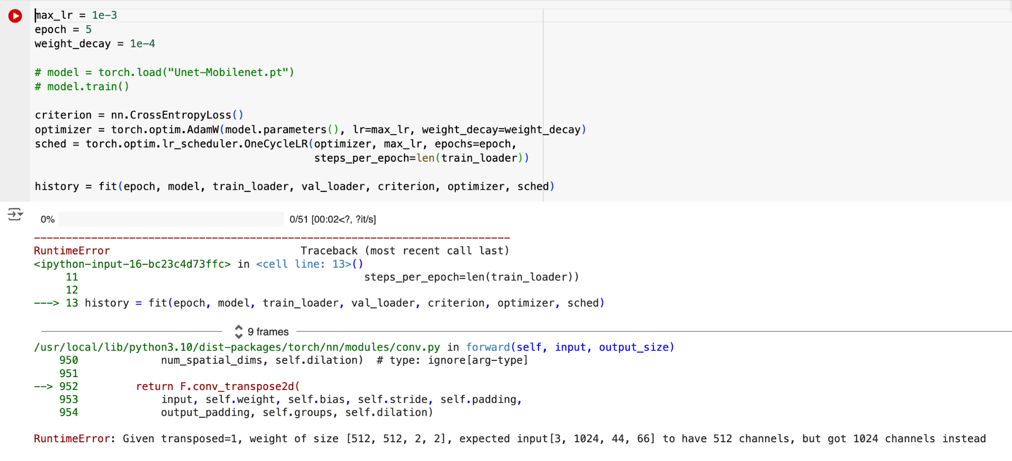
CHALLENGES
Challenges we came across:
Image sizes too big as an input
Original image slicer required image_slicer which kept crashing
Issues with dimensions in conv2d
Bugs in code
Issue with an early exit condition
Training the model took time

Slide 14


FUTURE IMPROVEMENTS
Future Improvements we could do:
Using more data
Train more epochs
Add precision and recall so that it’s easier to understand our results
Fine-tuning model to be able to pick up on more objects
Looking into different models and comparing their performance to the U-net model we used
Looking into instance segmentation, where the model is able to identify each individual object (e.g. person 1, person 2)

Slide 15

ETHICAL IMPLICATIONS
Privacy
Legal
Misuse
Dependency
Data privacy and consent
Challenges in Anonymization
Theft of Data
Data ownership
Unauthorized & unethical use
Surveillance
Discrimination
Overreliance
Accountability

Slide 16
REFERENCES
www.v7labs.com. (n.d.). Beginner’s Guide to Semantic Segmentation [2022]. [online] Available at: https://www.v7labs.com/blog/semantic-segmentation-guide.
www.tugraz.at. (n.d.). ICG - DroneDataset. [online] Available at: https://www.tugraz.at/index.php?id=22387.
Bajwa, A. (2022). Image Segmentation with U-Net. [online] Analytics Vidhya. Available at: https://www.analyticsvidhya.com/blog/2022/10/image-segmentation-with-u-net/.
rupert ai (2023). The U-Net (actually) explained in 10 minutes. [online] www.youtube.com. Available at: https://www.youtube.com/watch?v=NhdzGfB1q74.

